Slide 1
Pharmacy
Management System
(A Python Desktop Application)
Prepared By Team CAPS:
Chandrajit Mondal
Abhisekh Mundle
Preetam Chatterjee
Subham Burnwal

Slide 2
Introduction
Presenting a Pharmacy Management System we Developed using Python. This Project aims to serve the basic purposes and services of a Pharmacy Store like Billing, Updating Stock, etc. This is a Desktop Application for Windows Systems.
This Application is a GUI based system with a simple User Interface implemented using Python’s ‘tkinter’ module. This program manages several day to day operations of the medical store with the clicks of simple buttons that provides a very easy and simple way of managing the store.

Slide 3
Introduction
This project is developed for medical stores to manage different inventories and items, customers and suppliers details as well as staff like pharmacists working in the store. Overall the project aims to make all activities of a pharmacy faster and efficient.
There is an external database file to store all catalogue, sales, and employee data. For this we have used a SQLite3 database.

Slide 4
This program has different features for employees
and the admin
We can check
expired products and delete them
we can manage whole inventory and manage stocks
Features
we can search
inventory,
add new medicines for selling,
and we can sell to a customer using the billing form
This Project has the following Features :-
Adding new Stocks to Inventory
Deleting Stocks from Inventory
Searching the Inventory
Checking the Expiry Dates of medicines in Inventory
A Billing system that provides Receipt of purchased medicine to the customer
Revenue Checker that’s gives the Total Sale of the day
We definitely have future plans for this project referring in our upcoming slides.

Slide 5
DFD
how many
more types of dfd?
first level DFD, and second level DFD,
both types of DFD show the data flow in a more
detailed way
if sir asks why context dfd, sir it is too long to show clearly in a powerpoint
presentation
Following is a context data flow diagram of the overall working of this Pharmacy Management System. It demonstrates the requests and flows of data between the user and different areas of the management system.

Slide 6
We decided to
not include employees
in the program
at this stage,
but we kept it
for future updates.
the admin uses the pharmacy management system to give service to the customer
Once admin confirms the payment, the program generates a bill for the customer,
and prints it
The bill also gets stored in the database for future reference
ADMIN
Payment Confirmation
Bill Generation
Request
Response
Request
Response
Check Expiry/ Search Medicine
Return Results
PHARMACY MANAGEMENT SYSTEM
CUSTOMER
Command
Payment
Return Status
Check
Command Validity
Check Availability
Make Changes
DATABASE
Context DFD

Slide 7
ERD
In Crows-foot
Notation,
we use boxes to show entities,
and to show the relationships
between these boxes, we use lines.
Different shapes
at the ends of
these lines
represent different
types of
relationship.
There are three
types of these shapes, ring,
dash and
crows-foot
Following is an entity relationship diagram of the overall working of this Pharmacy Management System. It shows all the tables in our database, with their fields and primary keys.
It also shows the types of relationships between the entities of this Pharmacy Management System and explains the relationship between all of them.
For the Entity relationship diagram we used Crow’s Foot Notation

Slide 8
ERD
In Crows-foot
Notation,
we use boxes to show entities,
and to show the relationships
between these boxes, we use lines.
The database of Pharmacy management has 2 database files: admin.db and pharma.db. The pharma database stores tables cus, med, bills. While the admin database stores only one table: log
The cus table stores the customer details,
med table stores medicine and catalogue details,
bills table stores all bills created by the program, and
the log table stores only the login id and password of
the admin and customers.
Entities And Tables

Slide 9
when the admin sells medicines
this software
automatically
generates bills for customers.
It will also store the bills in database for later reference
To
med
cus
customer
medicine
c_id
name
address
phone
gender
sl_no
cost
expDate
location
mfgDate
name
purpose
quantity
type
Manages
this type of line is called crows foot.
admin
log
phone
username
password
type
Sells
It means
one-to-many relationship,
like one pharmacy can manage many medicines
bills
bill_no
Total_cost
bill
bill_dt
cus_phone
cus_name
items
val_id
admin can manage the medicine inventory,
delete or add stocks, and edit all their data
Has
Has
pharmacy
admin.db
pharma.db

Slide 10
CODE & REUSLTS

Slide 11
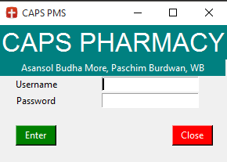
Login Area

Slide 12
close previous window →
Start login menu
add software title
add logo(icon)→
add header →
add address →
Add input area→
for username
Add input area
for password →
add login button
add close button
on pressing login button, this function will→
check database
for the username and password
if found, login→
def login_menu(): # for login window---------------LOGIN WINDOW global un, pwd, flag, root, apt if flag == 'apt': apt.destroy() root = Tk()
root.title('CAPS PMS') root.iconbitmap('icon.ico')
Label(root, text="CAPS PHARMACY", bg="teal", fg="White", font="Arial 25").grid(row=0, column=0, columnspan=5)
Label(root, text=" Asansol Budha More, Paschim Burdwan, WB ", bg="teal",fg="White").grid(row=1,column=0,columnspan=5)
Label(root, text='Username').grid(row=3, column=0) un = Entry(root, width=20) un.grid(row=3, column=1, columnspan=4) un.bind("<Return>", focus_next_widget) un.focus()
Label(root, text='Password').grid(row=4, column=0) pwd = Entry(root, width=20) pwd.grid(row=4, column=1, columnspan=4) pwd.bind("<Return>", check) Label(root, text=' ').grid(row=5, column=0, columnspan=5)
Button(root, width=6, text='Enter', command=check, bg="green", fg="white").grid(row=6, column=0)
Button(root, width=6, text='Close', command=root.destroy, bg="red", fg="white").grid(row=6, column=4)
Label(root, text=' ').grid(row=7, column=0, columnspan=5) root.bind_class("Button", "<Return>", on_return) root.mainloop() def check(self=NONE): # for enter button in login window global un, pwd, login, l, root u = un.get() p = pwd.get() l.execute("select * from log") for i in l: if i[0] == u and i[1] == p and u == 'admin': root.destroy() open_win() elif i[0] == u and i[1] == p: root.destroy() open_cus() login.commit()

Slide 13
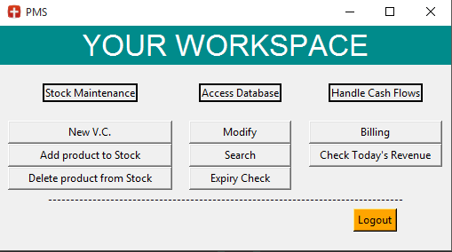
Main Menu

Slide 14
This is the Main Menu window→
Create tkinter Window →
Give App Title→
Button to add →
Valued Customer
Button for Add
Product Menu→
Delete Product→
Modify Product→
Search Button→
Expiry Check→
Check Revenue Menu→
Billing Menu→
and Log Out→
def open_win(): # OPENS MAIN MENU---------------MAIN MENU global apt, flag flag = 'apt‘
apt = Tk()
apt.title("PMS")
Label(apt, text=" YOUR WORKSPACE ", bg="cyan4", fg="white", font="Arial 25").grid(row=0, column=0, columnspan=3)
Label(apt, text="Stock Maintenance", bd=2, relief="solid").grid(row=2, column=0)
Button(apt, text='New V.C.', width=25, command=val_cus).grid(row=4, column=0)
Button(apt, text='Add product to Stock', width=25, command=stock).grid(row=5, column=0)
Button(apt, text='Delete product from Stock', width=25, command=delete_stock).grid(row=6, column=0)
Label(apt, text="Access Database", bd=2, relief="solid").grid(row=2, column=1)
Button(apt, text='Modify', width=15, command=modify).grid(row=4, column=1)
Button(apt, text='Search', width=15, command=search).grid(row=5, column=1)
Button(apt, text='Expiry Check', width=15, command=exp_date).grid(row=6, column=1)
Label(apt, text="Handle Cash Flows", bd=2, relief="solid").grid(row=2, column=2)
Button(apt, text="Check Today's Revenue", width=20, command=show_rev).grid(row=5, column=2)
Button(apt, text='Billing', width=20, command=billing).grid(row=4, column=2) Button(apt, text='Logout', command=again, bg="orange", fg="black").grid(row=13, column=2)
apt.mainloop()

Slide 15
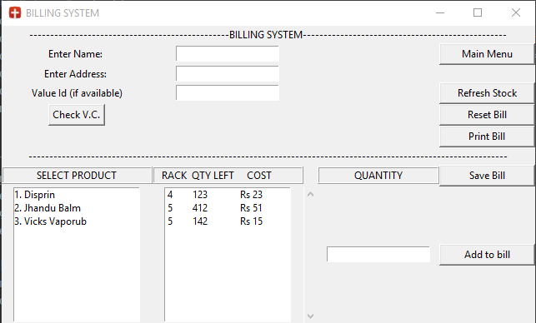
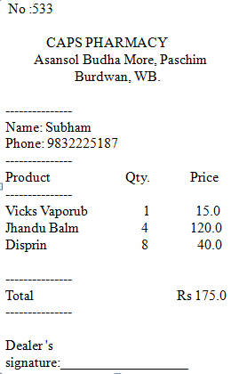
Billing Form

Slide 16
Close previous window →
Start window
for billing menu→
Menu name →
Add input area→
for name
Add input area
for phone→
Add input for
value_id →
different buttons:
Add item to buy
Set Quantity→
previous menu→
refresh data→
clear bill →
print the bill→
save the bill file→
def billing(): # to create bills for customer---------------BILLING system global connection, cur_col, apt, flag, t, name, name1, add, st, names, qty, sl, qtys, vc_id, n, namee, lb1 cur_col.execute("select *from med") if flag == 'st': st.destroy() else: apt.destroy()
flag = 'st' st = Tk() st.title('BILLING SYSTEM') Label(st, text='-' * 48 + 'BILLING SYSTEM' + '-' * 49).grid(row=0, column=0, columnspan=7)
Label(st, text='Enter Name: ').grid(row=1, column=0) name1 = Entry(st) name1.grid(row=1, column=1)
Label(st, text='Enter Phone: ').grid(row=2, column=0) phone = Entry(st) phone.grid(row=2, column=1) Label(st, text="Value Id (if available)").grid(row=3, column=0) vc_id = Entry(st) vc_id.grid(row=3, column=1)
Label(st, text='SELECT PRODUCT', width=25, relief='ridge').grid(row=7, column=0) Label(st, text=' RACK QTY LEFT COST ', width=25, relief='ridge').grid(row=7, column=1) Button(st, text='Add to bill', width=15, command=append2bill).grid(row=8, column=6) Label(st, text='QUANTITY', width=20, relief='ridge').grid(row=7, column=5)
qtys = Entry(st) qtys.grid(row=8, column=5) Button(st, width=15, text='Main Menu', command=main_menu).grid(row=1, column=6)
Button(st, width=15, text='Refresh Stock', command=refresh).grid(row=3, column=6)
Button(st, width=15, text='Reset Bill', command=billing).grid(row=4, column=6)
Button(st, width=15, text='Print Bill', command=print_bill).grid(row=5, column=6)
Button(st, width=15, text='Save Bill', command=make_bill).grid(row=7, column=6) st.mainloop()

Slide 17
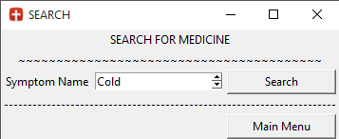
Search Menu

Slide 18
close previous window→
start window→
for login menu.
Add menu name
add input area→
symptom name
search button→
button to return
to main main→
search function→
get and print list of medicines for the selected problem, from database
button to close search results→
def search(): # search window medicine and symptom details---------------SEARCH MEDICINE RACK & SYMPTOMS global connection, cur_col, flag, st, mn, sym, flags flag = 'st' apt.destroy()
st = Tk() st.title('SEARCH') Label(st, text=' SEARCH FOR MEDICINE ').grid(row=0, column=0, columnspan=3)
Label(st, text='Symptom Name').grid(row=3, column=0) sym = Spinbox(st, values=symp) sym.grid(row=3, column=1)
Button(st, width=15, text='Search', command=search_med).grid(row=3, column=2)
if flags == 'apt1': # for customer's medicine search Button(st, width=15, text='Main Menu', command=main_cus).grid(row=6, column=2) else: # for admin search Button(st, width=15, text='Main Menu', command=main_menu).grid(row=6, column=2) st.mainloop()
def search_med(): global connection, cur_col, st, sym, columns cur_col.execute("select * from med") y = [] x = 0
for i in cur_col: if i[5] == sym.get(): y.append(str(i[0]) + '. ' + str(i[1]) + ' Rs ' + str(i[4]) + ' Rack : ' + str(i[7]) + ' Mfg : ' + str(i[8])) x = x + 1 top = Tk()
for i in range(len(y)): Label(top, text=y[i]).grid(row=i, column=0) Button(top, text='OK', command=top.destroy).grid(row=5, column=0)
connection.commit() top.mainloop()

Slide 19
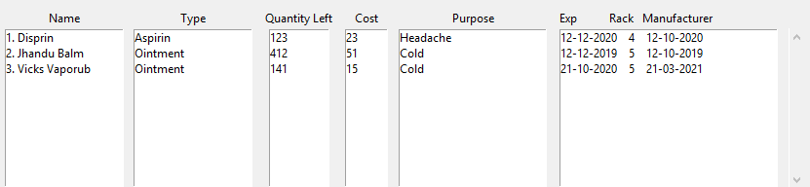
View Catalogue
The View Catalogue frame is a reusable tkinter frame, which is displayed in many window, like in the Add Product window, Delete Product window, and Search Window too, as required.

Slide 20
This function is used by the View Catalogue frame
to display data
in a proper table.
There are 6 columns in a table for the 6 properties of every medicine
like name or cost
Here give it a→
scroll function so user can scroll if theres more data
and adjust the→
table layout.
This block of code inserts or deletes items from the List of Selected Items→
def ref(): # creates a multi-listbox manually to show the whole database global sto, connection, cur_col def on_vsb(*args): lb1.yview(*args) lb2.yview(*args) lb3.yview(*args) lb4.yview(*args) lb5.yview(*args)
lb6.yview(*args) cx = 0 vsb = Scrollbar(orient='vertical', command=on_vsb) lb1 = Listbox(sto, yscrollcommand=vsb.set) lb2 = Listbox(sto, yscrollcommand=vsb.set) lb3 = Listbox(sto, yscrollcommand=vsb.set, width=10)
lb4 = Listbox(sto, yscrollcommand=vsb.set, width=5)
lb5 = Listbox(sto, yscrollcommand=vsb.set, width=15) vsb.grid(row=15, column=6, sticky=N + S) lb1.grid(row=15, column=0) lb2.grid(row=15, column=1) lb3.grid(row=15, column=2)
lb4.grid(row=15, column=3)
lb5.grid(row=15, column=4)
lb6.grid(row=15, column=4)
cur_col.execute("select *from med") for i in cur_col: cx += 1 seq = (str(i[0]), str(i[1])) lb1.insert(cx, '. '.join(seq)) lb2.insert(cx, i[2]) lb3.insert(cx, i[3]) connection.commit()
lb4.insert(cx, i[4])
lb5.insert(cx, i[5])

Slide 21
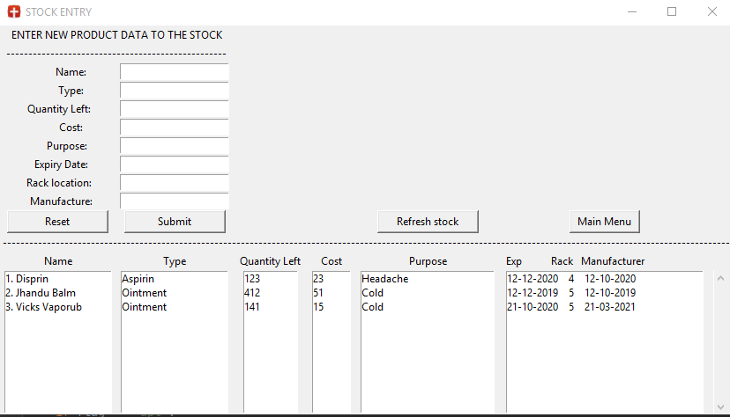
Add Product

Slide 22
Close previous window→
Give name→
Make a FORM to enter all data for medicine→
Submit Button→
Reset form→
Display data→
after adding item
Back button→
Submit function:
This function connects to database and runs the QUERY
to delete selected
medicines from inventory
def stock(): # add to stock window---------------ADD TO STOCK global cur_col, connection, columns, accept, flag, sto, apt apt.destroy()
sto = Tk() sto.title('STOCK ENTRY')
Label(sto, text='ENTER NEW PRODUCT DATA TO THE STOCK').grid(row=0, column=0, columnspan=2)
for i in range(1, len(columns)): Label(sto, width=15, text=' ' * (14 - len(str(columns[i]))) + str(columns[i]) + ':').grid(row=i + 2, column=0) accept[i] = Entry(sto) accept[i].grid(row=i + 2, column=1)
Button(sto, width=15, text='Submit', command=submit).grid(row=12, column=1)
Button(sto, width=15, text='Reset', command=reset).grid(row=12, column=0)
for i in range(1, 6): Label(sto, text=columns[i]).grid(row=14, column=i - 1)
Label(sto, text='Exp Rack Manufacturer ').grid(row=14, column=5)
Button(sto, width=10, text='Main Menu', command=main_menu).grid(row=12, column=5)
ref()
sto.mainloop()
def submit(): # for new stock submission global accept, connection, cur_col, columns, sto prev = time.perf_counter() x = [''] * 10 cur_col.execute("select * from med") y=0 for i in cur_col: y = int(i[0]) for i in range(1, 9): x[i] = accept[i].get() sql = "insert into med values('%s','%s','%s','%s','%s','%s','%s','%s','%s')" % (y + 1, x[1], x[2], x[3], x[4], x[5], x[6], x[7], x[8]) cur_col.execute(sql) cur_col.execute("select * from med") connection.commit() now = time.perf_counter() print(now - prev) main_menu()

Slide 23
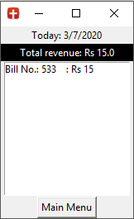
Daily Revenue

Slide 24
Close previous window→
Fetch & display Today’s Date→
Get all bills with Todays date &
Add all Total ₹ to get Grand total→
Then print it→
give this window a Name, and add a scrollbar to see all bills →
Now display each
bill’s No, and Total ₹ value, in a list.
button to return to main menu→
def show_rev(): # opens revenue window---------------TOTAL REVENUE global connection, cur_col, flag, rev apt.destroy()
flag = 'rev' rev = Tk() total = 0.0 cb = ('cus_name', 'cus_add', 'items', 'Total_cost', 'bill_dt', 'bill_no', 'bill', 'val_id')
today = str(time.localtime()[2]) + '/' + str(time.localtime()[1]) + '/' + str(time.localtime()[0]) Label(rev, text='Today: ' + today).grid(row=0, column=0)
cur_col.execute('select * from bills') for i in cur_col: if i[4] == today: total += float(i[3])
print(total)
Label(rev, width=22, text='Total revenue: Rs ' + str(total), bg='black', fg='white').grid(row=1, column=0) cx = 0 vsb = Scrollbar(orient='vertical')
lb1 = Listbox(rev, width=25, yscrollcommand=vsb.set) vsb.grid(row=2, column=1, sticky=N + S) lb1.grid(row=2, column=0) vsb.config(command=lb1.yview)
cur_col.execute("select * from bills") for i in cur_col: if i[4] == today: cx += 1 lb1.insert(cx, 'Bill No.: ' + str(i[5]) + ' : Rs ' + str(i[3])) connection.commit()
Button(rev, text='Main Menu', command=main_menu).grid(row=15, column=0)
rev.mainloop()

Slide 25
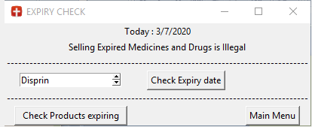
Other features
Expiry Check

Slide 26
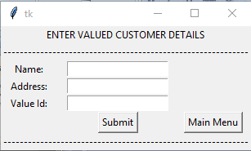
Other features
Valued Customers
get products at discounted rate
Add Valued Customer

Slide 27
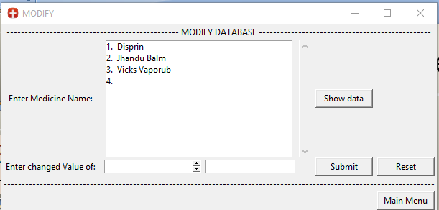
Other features
Modify Product Details

Slide 28
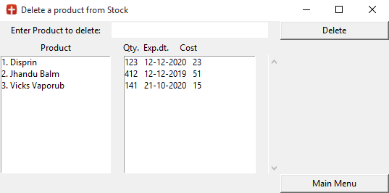
Other features
Delete Product

Slide 29
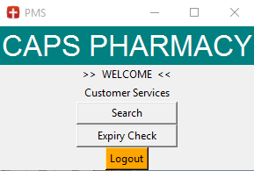
Other features
This is the customer’s version of the Main Menu.
It has limited options, at the moment.
Through it customers can search for medicines, check their availability and expiry dates.
Customer Services

Slide 30
Future Scope
And we would have already done all this with a standard UI
if the original submission date of 15th July was not changed to 7th,
and then 4th
aal is well
This Project holds a very strong potential for the future. As for our very first thought we have thought of improving our customer side of the Application where the customer will directly claim the services from the Application like - buying medicines, claiming discounts, also getting suggestions according to the symptoms entered. Further it is very much possible to suggest doctors with their contacts.
We also plan for a more attractive and lite User interface in the future, with more efficient and smooth animations. We plan for a all in one system in the future, so that the customer doesn’t have to go elsewhere , He / She can have every pharmacy services in their finger tips.

Slide 31
Conclusion
In the End we would like to conclude that this is a very lite weight desktop application developed only using python and it definitely serves its purpose very well that is to manage basic day to day tasks of pharmacy store. All the hard human labour can be done through this automated application with very ease.
Building of this project is also not very complex, as we have only used python with basic tools and features that python offers and Database with SQLite3. In the process of building this application we faced many errors and problems but we really did tried hard and succeeded in completing this project on Time, we did got many things to learn from this project. We are really looking forward to improve this application and add more features. But up till then we promise a stable and reliable performance from this application.

Slide 32
Thank You

